Slide 1
Can a model beat the latest PM2.5 reading?
PREDICTIVE ANALYTICS GROUP PROJECT
Short-horizon forecasts at Marine Terrace, Singapore: 1, 3 and 6 hours ahead
Group [N] · Energy and Environment · one low-cost sensor, April to August 2026
Notes:
Open with the decision: an operations lead wants to know the next few hours of air quality. The question is whether a model adds anything beyond simply reusing the latest reading. We will show the answer honestly, including where it does not help.

Slide 2
Should sensor-based forecasts support public air-quality services?
Who decides
What they decide
Our question
A government environmental agency (NEA, under the Ministry of Sustainability and the Environment): the director responsible for air-quality monitoring and public communication.
Where to invest monitoring and data effort, and whether short-horizon forecasts from low-cost sensors deserve a place in public services.
Can PM2.5 be forecast 1, 3 and 6 hours ahead better than reusing the latest reading, and do wind and daily weather help?
Scope: one low-cost sensor at Marine Terrace. A planning and investment input, not a haze early-warning system.
Short-horizon PM2.5 forecasting · Marine Terrace
2
Notes:
The audience is a government decision-maker. The decision is about investment and policy, not about a single day's operations. Stress the scope: one sensor, an input to planning, not an alerting system.

Slide 3
Five months of hourly data from one sensor
2,934
17 days
24
observed hours out of 3,446 on the hourly grid (85 %). Missing hours stay missing.
longest sensor outage (28 April to 15 May). Features never bridge it.
exact-zero readings, treated as dropouts and tested both ways.
Sources: OpenAQ (AirGradient sensor), Meteorological Service Singapore daily weather at Marina Barrage, hourly wind direction from the data.gov.sg API.
Short-horizon PM2.5 forecasting · Marine Terrace
3
Notes:
Data quality in numbers. The outage and the zeros are documented and the zero decision was checked for sensitivity. Source links and access dates are in the notebook.

Slide 4
The test was designed to be fair to the baseline
Time order only
No leakage
Chronological 70 / 15 / 15 split by target time. Samples straddling a boundary are purged.
Wind from the last completed hour, daily weather from the previous day, targets never filled. A perturbation test confirms it.
Tuning without the test set
Choice fixed first
Two shortlisted models, grid search, four expanding-window folds on train plus validation, scored by MAE.
Lowest cross-validated error wins, or persistence if nothing beats it. The test period is scored once.
Short-horizon PM2.5 forecasting · Marine Terrace
4
Notes:
This slide is for credibility with the panel: the result is trustworthy because the baseline was given a fair fight and the test set was untouched during selection.

Slide 5
Persistence is hard to beat for the next 3 hours
Horizon | Final model (chosen by CV) | Test MAE | Persistence MAE | MAE skill
1 h | ElasticNet, tuned | 5.22 | 5.31 | +1.6 %
3 h | ElasticNet, tuned | 8.28 | 8.52 | +2.8 %
6 h | ElasticNet, tuned | 8.84 | 10.97 | +19.5 %
MAE in µg/m³ on 13 to 31 August 2026 (about 420 hours per horizon). Skill = 1 − model MAE / persistence MAE. At 1 h and 3 h the gain is about 2 to 3 %, which has little practical value.
Intervals use a 24-hour moving-block bootstrap and are approximate.
5
Notes:
Headline result. The model is selected by cross-validation before the test period. Intervals: 1 h +0.8 to +2.2 percent, 3 h +1.9 to +3.4 percent, 6 h +11.9 to +26.8 percent. Be upfront that the short-range gain is small.

Slide 6
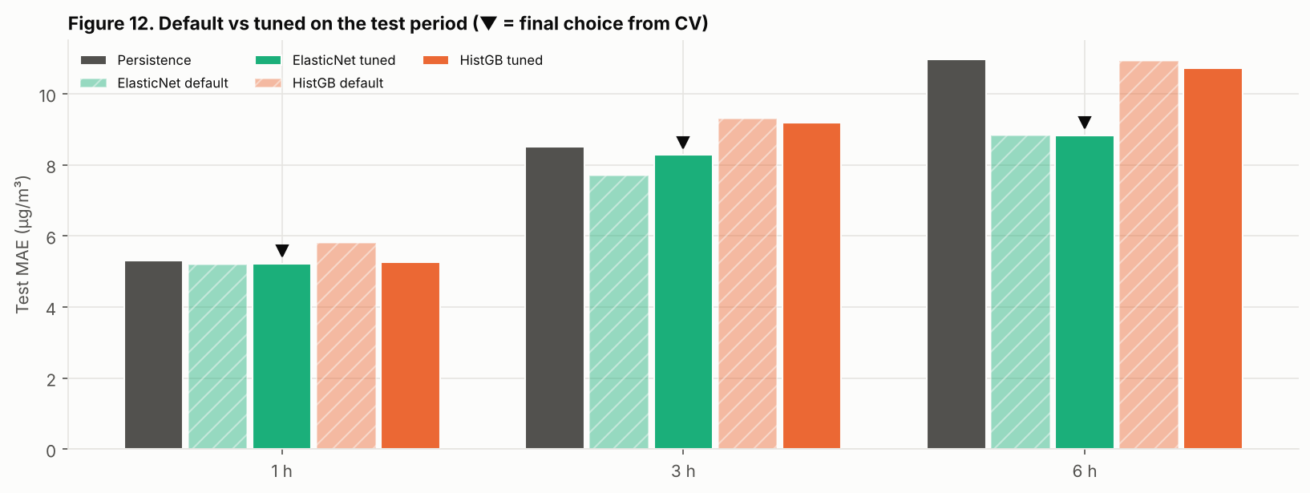
Six hours ahead is where the model earns its place
+19.5 %
8.84 against 10.97 µg/m³. Tuning improved cross-validation error, but not reliably the test error: at 3 h the untuned model scored 7.69 on test against 8.28 tuned.
MAE skill at 6 h, interval +11.9 % to +26.8 %
Figure: test MAE by horizon, default versus tuned (▼ marks the model chosen by cross-validation).
6
Notes:
The one horizon with meaningful value. Be honest about tuning: it helps in cross-validation but the test gain is not consistent, which is why the choice was made on cross-validation alone.

Slide 7
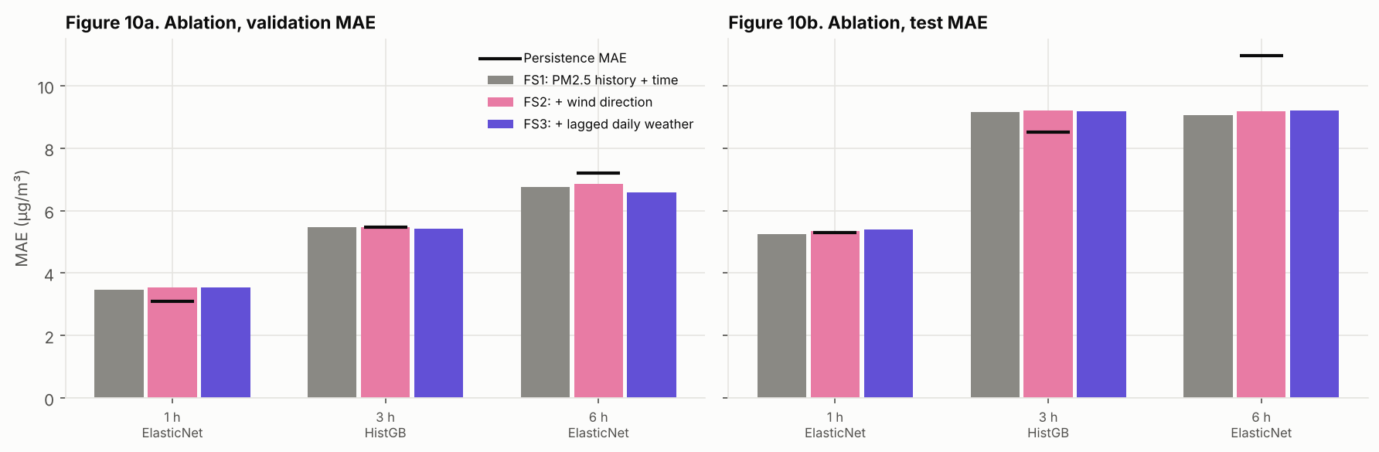
Wind and lagged weather add little dependable value
Raw pattern, not a forecast gain
After history is known
Median PM2.5 differs by 18 µg/m³ between wind sectors (SE highest, W lowest), but this is tangled with time of year.
Adding wind or lagged weather never met our rule: lower error on validation and test, with an interval that excludes zero.
Figure: feature ablation. Importance and coefficients describe association, not causation.
7
Notes:
Answer the research question directly: the external features do not help once the sensor history is used. The wind station is unknown and daily weather comes from another location, so this does not rule out value from better data.

Slide 8
Errors are five to eight times larger when PM2.5 is high
Horizon | High hours (> 55) | MAE on high hours | MAE on other hours
1 h | 16 | 31.6 | 4.2
3 h | 16 | 35.2 | 7.2
6 h | 15 | 40.8 | 7.6
Only about 16 test hours exceed 55 µg/m³, far too few to judge spike detection. The level also drifted: mean PM2.5 was 17.5 in training, 27.8 in validation and 35.4 in test.
So the forecasts must not trigger health or operational alerts.
MAE in µg/m³, final models on the test period (13 to 31 August 2026).
8
Notes:
Where the model fails. This justifies the scope guard in the recommendations. The October haze season is not in the data, so we make no claim about extreme events.

Slide 9
What the evidence says government should do next
1 · Fund the data, not a complex model
2 · Pilot the 6-hour outlook, do not deploy it
3 · Keep people in charge of alerts
Evidence: errors are 5 to 8 times larger when PM2.5 is high, from only about 16 high hours.
Evidence: the latest reading is already hard to beat for 3 hours, and wind and daily weather added nothing.
Evidence: about 20 % lower error than the latest reading at 6 hours, on one sensor and one month of test data.
Action: official alerts stay with reference-grade monitoring and expert judgement. Collect haze-episode data first; evaluate spike detection before any automation.
Action: NEA and the weather service prioritise sensor uptime (outages reached 17 days), calibration against reference monitors, and co-located hourly wind speed and direction.
Action: run it internally in shadow mode at a few sensors through the haze season, compare weekly with the latest reading, and set a go or no-go criterion before any public use.
Each recommendation follows from a finding on slides 5 to 8.
9
Notes:
Frame the recommendations around what the results mean for public decisions, not around the forecasting tool. Government owners: NEA monitoring operations and the Meteorological Service Singapore for data; an NEA analytics team for the pilot; the existing alert process stays human-led. Success measures: sensor uptime, calibration error against reference monitors, and weekly pilot error versus the latest reading through the haze season.

Slide 10
A staged path with clear checkpoints
Now to 3 months
Haze season
Go or no-go
Fix the data base: sensor uptime and freshness checks, calibration against reference monitors, hourly wind from a known, nearby station.
Run the 6-hour outlook in shadow mode at a few sensors, with monthly retraining. Review weekly error against the latest reading.
Decide on wider use only if the pilot keeps beating the latest reading, including in high-PM2.5 hours. Otherwise stop at low cost.
Risks to manage: public over-reliance on a forecast that fails in pollution episodes, low-cost sensor bias, and drift (the mean level doubled across five months). Compute cost is small; the full pipeline runs in about three minutes.
Short-horizon PM2.5 forecasting · Marine Terrace
10
Notes:
Feasibility for a government audience: low cost, staged, with a stop option. Owners: NEA monitoring operations and the Meteorological Service Singapore for data; an analytics team for the pilot. The go or no-go criterion is set before the pilot starts.

Slide 11
Limitations the panel should weigh
One low-cost sensor; calibration and humidity can bias readings.
The data do not cover the October haze episode.
A 17-day outage and month-end gaps reduce usable data.
Daily weather is coarse and from another station.
The wind station and its distance are unknown.
No wind speed, fire or satellite data.
Few extreme hours; hourly values are autocorrelated, so intervals are approximate.
Not a validated 24 to 48 hour warning system.
Short-horizon PM2.5 forecasting · Marine Terrace
11
Notes:
State the limits plainly; they are the reason for the recommendations on data and scope.

Slide 12
Backup: tuning search and cross-validated error
Model | Search space | 1 h | 3 h | 6 h
ElasticNet | alpha × l1_ratio (12) | 5.42 → 4.67 | 7.52 → 7.35 | 8.49 → 8.48
HistGB | rate × depth × leaf (18) | 6.55 → 5.74 | 9.30 → 8.75 | 9.83 → 9.35
Persistence | none | 4.77 | 7.73 | 9.29
Cross-validated MAE (µg/m³), default → tuned, four expanding-window folds on train plus validation. The default configuration is inside every grid, so tuning cannot do worse in cross-validation. Random Forest was in the initial comparison but not shortlisted.
Short-horizon PM2.5 forecasting · Marine Terrace
12
Notes:
Use if asked about tuning. Fold-to-fold variation is large (standard deviation about 1.6 to 2.7 µg/m³), so small differences between configurations are not meaningful.

